Slide 1


Slide 2

Differentiating Learning Paradigms
A journey into the world of machine learning. This presentation explores the nuances of Supervised, Unsupervised, Semi-Supervised, and Reinforcement Learning. Each paradigm offers unique approaches to problem-solving. Understand when to apply each for optimal results.

Slide 3


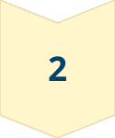
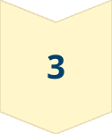
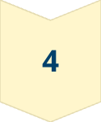
The Landscape of Machine Learning
Machine learning is a vast field. It has diverse techniques for extracting knowledge from data. We will navigate the primary categories of learning algorithms. Each category addresses different types of problems.
Supervised
Learning from labeled data.
Unsupervised
Discovering hidden structures.
Semi-Supervised
Combining labeled and unlabeled data.
Reinforcement
Learning through interaction.

Slide 4

Learning from Labeled Data
Supervised learning uses labeled datasets. It maps inputs to outputs. The algorithm learns from examples. It then predicts new, unseen data. Labeled data is crucial for effective learning.
1
Labeled Datasets
2
Mapping Inputs
Data with pre-defined answers.
Learning relationships between data points.
3
Predicting New Data
Applying learned knowledge to unseen examples.

Slide 5
Classification and Regression
Classification assigns data to categories. Examples include spam detection and image recognition. Regression predicts continuous values. Examples are stock prices and sales forecasts. Both are key applications.
Classification
Regression
Assigning data points to categories.
Predicting continuous values.

Slide 6
Common Supervised Learning Algorithms
Algorithms are essential to supervised learning. Linear Regression finds relationships between variables. Support Vector Machines (SVM) classify data by finding optimal boundaries. Neural Networks learn complex patterns through interconnected nodes.
Linear Regression
Support Vector Machines
Neural Networks
Finds linear relationships.
Classifies data with optimal boundaries.
Learns complex patterns.

Slide 7




Predicting Customer Churn
Supervised learning predicts customer churn. It analyzes past customer data. It identifies patterns of churn behavior. Businesses can take proactive measures. They can retain at-risk customers. Reduce customer churn.
Data Analysis
Pattern Identification
Proactive Measures
Analyzing past customer data.
Identifying patterns of churn.
Retaining at-risk customers.

Slide 8
Discovering Hidden Structures
Unsupervised learning uncovers hidden patterns. It analyzes unlabeled data. It finds clusters and reduces dimensionality. No pre-defined labels are needed. This reveals insights and structures.
Unlabeled Data
1
Analyzing data without pre-defined answers.
2
Cluster Finding
Grouping similar data points.
Dimensionality Reduction
3
Simplifying complex data.

Slide 9

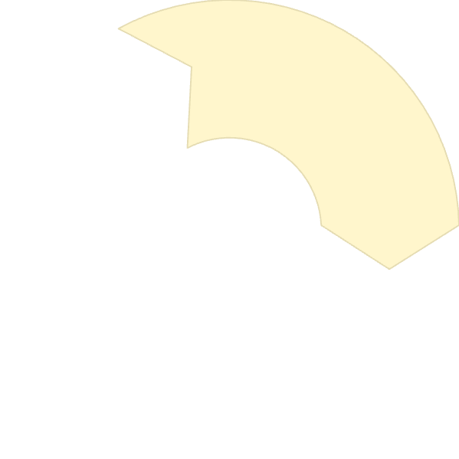

Clustering and Dimensionality Reduction
Clustering groups similar data points together. Customer segmentation is a practical application. Dimensionality reduction simplifies data. It reduces noise and improves algorithm performance. Both are vital techniques.
2
Segmentation
1
Clustering
Reduction
3

Slide 10


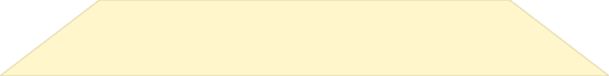
Common Unsupervised Learning Algorithms
K-Means clustering groups data into K clusters. Principal Component Analysis (PCA) reduces dimensionality. It identifies key components. Association Rule Mining finds relationships between items. Each has unique applications.
1
Association Rule Mining
2
Principal Component Analysis (PCA)
3
K-Means Clustering

Slide 11
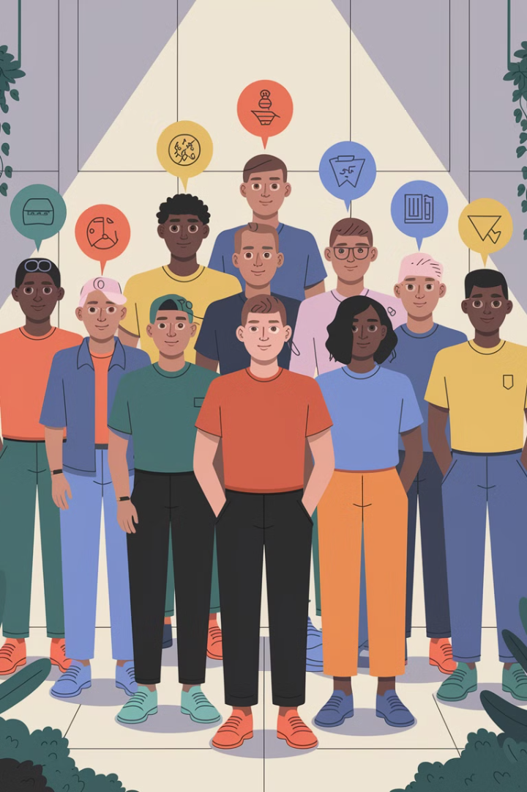

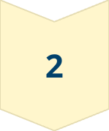
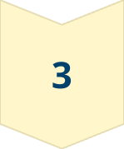
Customer Segmentation
Unsupervised learning segments customers. It groups them by behavior and preferences. This informs marketing and product strategies. It helps businesses target specific segments effectively. Increase customer satisfaction and loyalty.
Grouping
Customers by behavior.
Informing
Marketing strategies.
Targeting
Specific segments.

Slide 12
Leveraging Both Labeled and Unlabeled Data
Semi-supervised learning uses both. It trains models with limited labels. It leverages the abundance of unlabeled data. This improves accuracy and efficiency. It addresses the challenge of scarce labeled data.
1
Efficiency
2
Accuracy
3
Limited Labels

Slide 13
The Power of Combining Data
Combining labeled and unlabeled data is powerful. It improves model generalization and performance. Labeled data provides structure and guidance. Unlabeled data expands the dataset. It enhances robustness and adaptability.
Generalization
Guidance
Adaptability
Improves model performance.
Labeled data provides structure.
Enhances robustness.

Slide 14
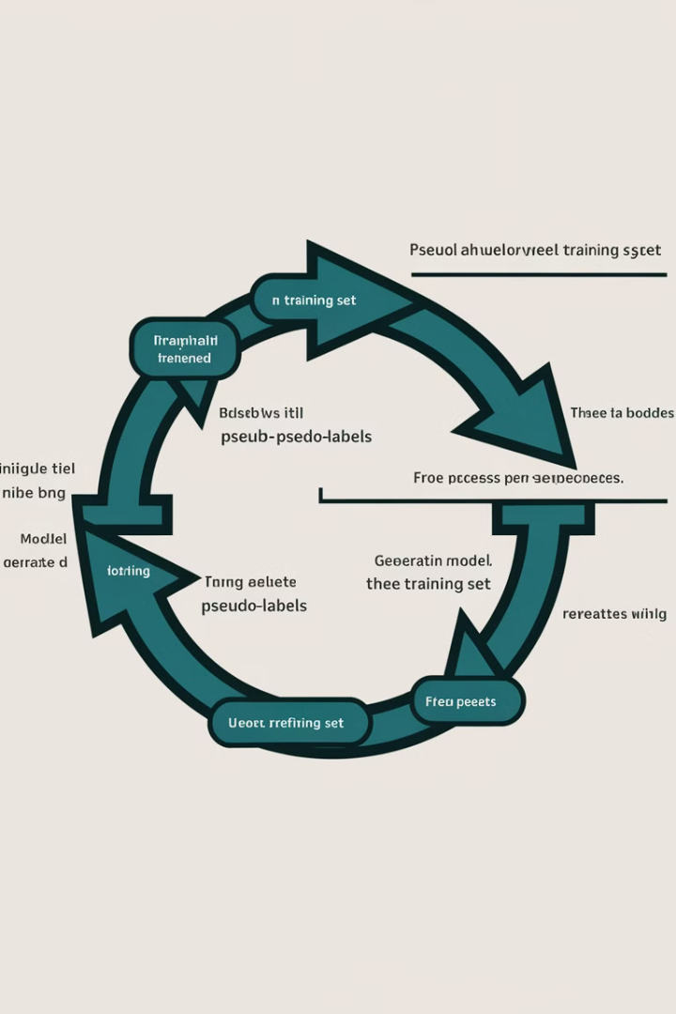
Semi-Supervised Learning Techniques
Pseudo-labeling assigns labels to unlabeled data. Self-training iteratively refines the model. It uses its own predictions. These techniques enhance learning. They maximize the use of available data.
1
Pseudo-Labeling
Assigns labels to unlabeled data.
2
Self-Training
Iteratively refines the model.

Slide 15



Image Classification with Limited Data
Semi-supervised learning classifies images. It is useful with limited labeled examples. It leverages unlabeled images for better performance. Applications include medical imaging and satellite imagery. Maximize data usage.
Medical Imaging
Satellite Imagery
Classifying medical scans.
Analyzing satellite data.

Slide 16

Learning through Interaction and Reward
Reinforcement learning trains agents. It learns through interaction with an environment. The agent receives rewards or penalties. It optimizes its actions over time. Goal: maximize cumulative reward.
Agent
Environment
Reward
Learns actions
Provides feedback
Guides learning

Slide 17

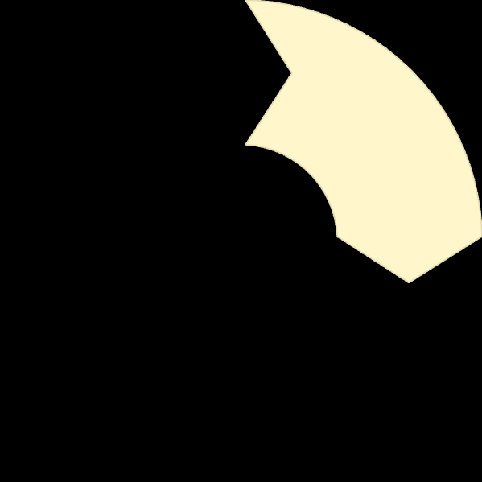


Key Components of Reinforcement Learning
The agent makes decisions. The environment provides context and feedback. The reward signals success or failure. Policy defines the agent’s strategy. These components are interconnected.
Agent
1
Environment
2
4
Policy
3
Reward

Slide 18

Reinforcement Learning Algorithms
Q-Learning learns optimal actions. Deep Q-Networks (DQN) use neural networks. Policy Gradients optimize policies directly. These algorithms drive advances. They are used across diverse applications.
Q-Learning
Deep Q-Networks (DQN)
Learns optimal actions.
Uses neural networks.
Policy Gradients
Optimizes policies directly.

Slide 19
Training an AI to Play Video Games
Reinforcement learning trains AI. It masters complex video games. The AI learns through trial and error. It adapts to game dynamics. It optimizes strategies for high scores. Achieves human-level performance.
Trial and Error
Adaptation
Optimization
Learning through experimentation.
Adjusting to game dynamics.
Maximizing scores.

Slide 20
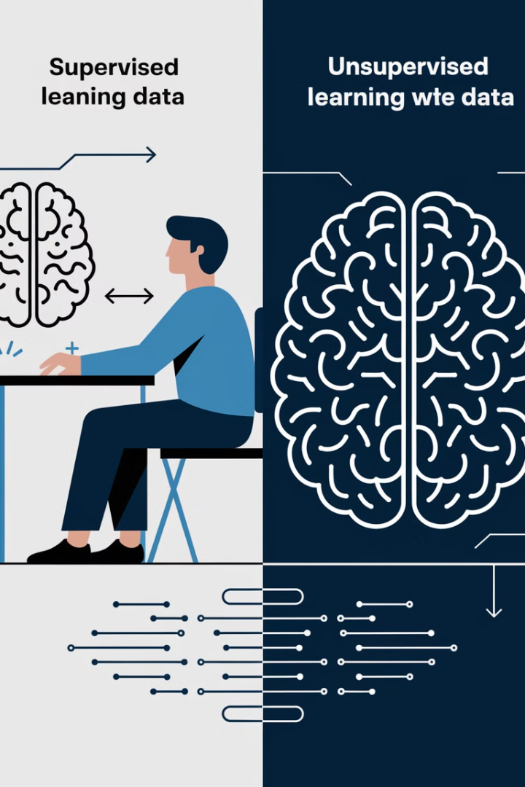
Supervised vs. Unsupervised
Supervised learning uses labeled data. Unsupervised learning uses unlabeled data. Supervised learning predicts outputs. Unsupervised learning discovers patterns. Each serves different purposes. Choose wisely.
Characteristic
Supervised
Unsupervised
Data
Labeled
Unlabeled
Goal
Prediction
Pattern Discovery

Slide 21
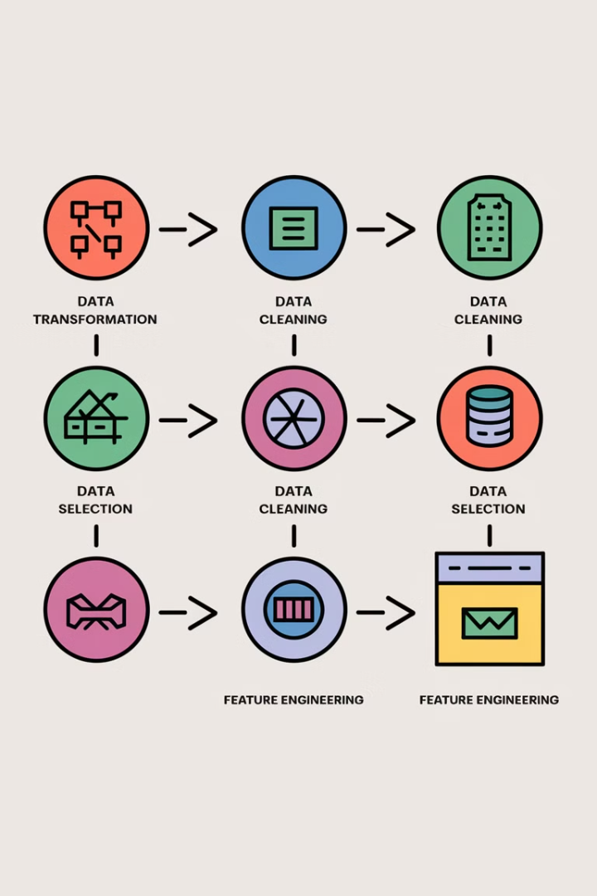
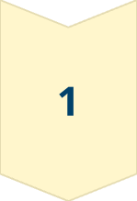
Feature Engineering
Feature engineering is crucial. Supervised learning requires relevant features. Unsupervised learning benefits from reduced noise. Select features carefully. Enhance model performance. Improve insights.
Relevance
Supervised Learning needs clear and understandable data
Noise Reduction
Unsupervised Learning benefits from noise reduction

Slide 22

Evaluating Model Performance
Supervised learning uses accuracy, precision, and recall. Unsupervised learning uses silhouette score and Davies-Bouldin index. Choose appropriate metrics. Understand model strengths and weaknesses. Fine-tune algorithms.
1
Accuracy
2
Precision
3
Recall
Measure overall correctness.
Measure positive predictions.
Measure true positives.

Slide 23
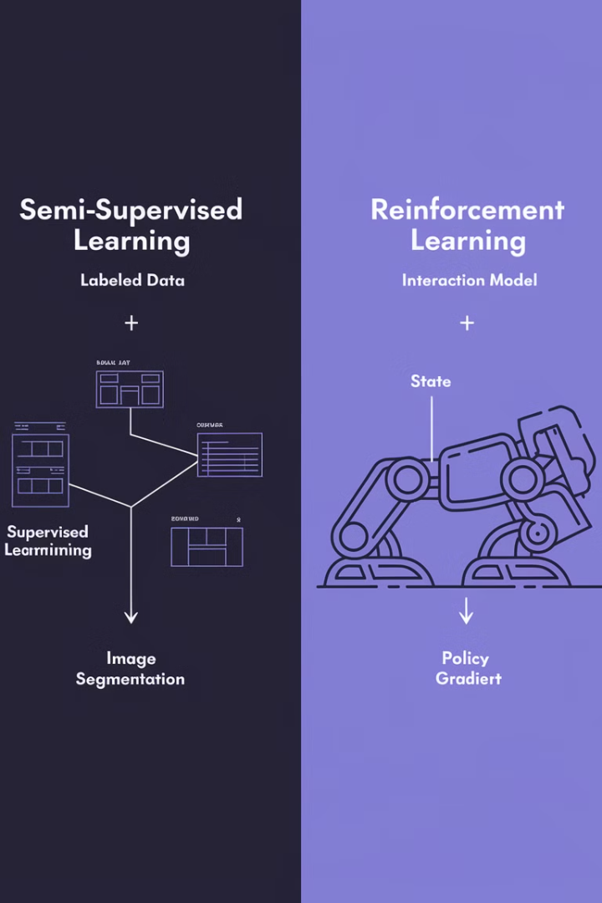
Semi-Supervised vs. Reinforcement
Semi-supervised learning combines data types. Reinforcement learning learns through interaction. Semi-supervised enhances limited labels. Reinforcement optimizes actions. Different approaches for different challenges.
Data Combination
Semi-supervised leverages labeled/unlabeled data.
Interaction Learning
Reinforcement learns through environment interaction.

Slide 24

Data Requirements
Semi-supervised learning needs both types. Reinforcement learning needs an environment. Semi-supervised benefits from more data. Reinforcement benefits from structured environments. Choose data strategically.
2
Data Types
Semi-Supervised Learning
1
Environment
Reinforcement Learning

Slide 25
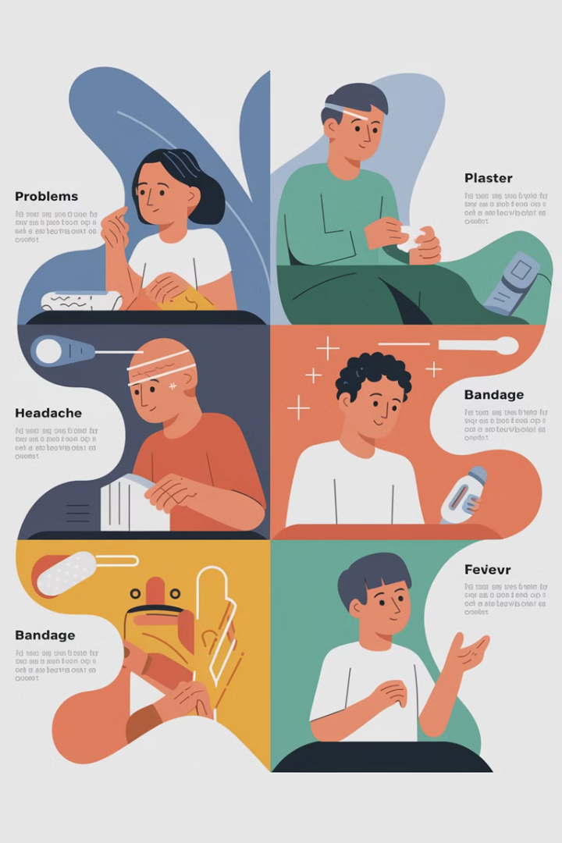
Application Scenarios
Supervised: classification and regression. Unsupervised: clustering and dimensionality reduction. Semi-supervised: limited labeled data. Reinforcement: sequential decision making. Match approach to problem.
Classification
Clustering
Sequential Decision Making

Slide 26

Ethical Considerations
Each paradigm raises ethical questions. Supervised data can reflect bias. Unsupervised data must be used responsibly. Semi-supervised methods need careful evaluation. Reinforcement learning needs fair reward structures.
1
Data Bias
Supervised learning
2
Responsible Use
Unsupervised learning
3
Careful Evaluation
Semi-supervised learning
4
Fair Rewards
Reinforcement learning

Slide 27
Bias in Supervised Data
Supervised data can contain bias. It reflects societal prejudices. Bias affects model fairness and accuracy. Mitigate bias through careful data collection. Implement bias detection techniques.
1
Mitigate bias
2
Bias affects model fairness and accuracy
3
Supervised Data

Slide 28

Responsible Use of Unsupervised Learning
Unsupervised learning discovers patterns. It must be used ethically. Avoid reinforcing stereotypes. Protect privacy and confidentiality. Ensure fair and transparent applications. Promote responsible data exploration.
Action
Why
Avoid stereotypes
Ethical use
Protect privacy
Confidentiality

Slide 29



The Future of Machine Learning
Machine learning evolves rapidly. Trends include AutoML and federated learning. Innovations address scalability and privacy. Expect more automation and decentralized approaches. The future looks promising.
AutoML
Federated Learning
Automated machine learning.
Decentralized approaches.

Slide 30

Emerging Research
Research focuses on robustness and explainability. New methods address adversarial attacks. Interpretability enhances trust and transparency. Focus on reliable and understandable AI. Promote ethical development.
1
Robustness
Protecting against attacks.
2
Explainability
Enhancing transparency.

Slide 31

Q&A
Time to answer your questions. Clarify concepts and address concerns. Engage in open discussion. Share insights and experiences. Promote understanding and collaboration.
Clarify Concepts
Address Concerns
Promote Understanding

Slide 32
Choosing the Right Paradigm
Select the learning paradigm carefully. Consider data availability and problem type. Supervised, unsupervised, semi-supervised, and reinforcement learning. Each offers unique advantages. Apply them effectively.
1
Apply Effectively
2
Consider Data and Problem
3
Select Learning Paradigm

